Slide 1
Internet Security (CI6240)
Week 2 – Mathematical Primer
Dr Martin Tunnicliffe
M.J.Tunnicliffe@kingston.ac.uk
Dr Eckhard Pfluegel
E.Pfluegel@kingston.ac.uk

Slide 2
Teaching Block 1
Introduction
Mathematical Primer
Classical Cryptography
Digital Symmetric Ciphers
Public Key Cryptography
(Reading Week)
Cryptographic Hash Functions
Networks and Network-Based Attacks
Firewalls and Secure Architectures
Cryptography on the Internet
In-Class Test 1
TB1 Wrap-Up

Slide 3
Topics Covered
Arithmetic and Number Systems
Prime and Composite Numbers
Integer Arithmetic
Modular Arithmetic
Number Bases
Logical Operators and Logic Gates
Frequency Analysis and Histograms
Notes:
These topics are not exhaustive, and the concepts will be built upon considerably in the coming weeks.

Slide 4
1.
Arithmetic and Number Systems

Slide 5
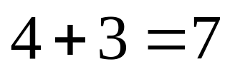
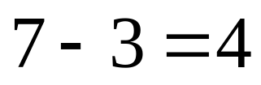
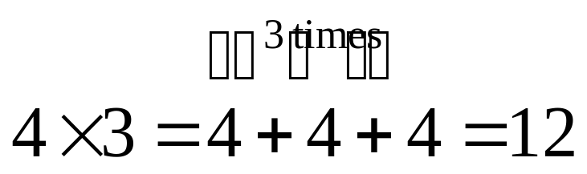
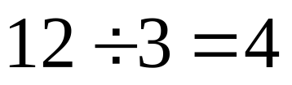
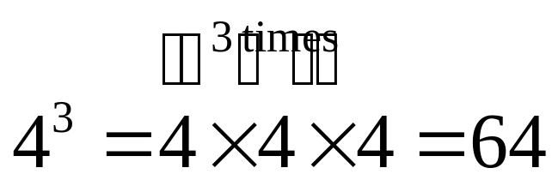
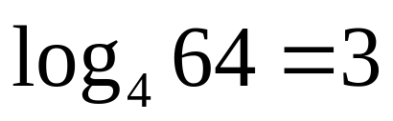
Basic Arithmetic Operations
Addition
Inverse operation: Subtraction
Multiplication: Repeated Addition
Inverse operation: Division
Note: Multiplication/division always happens before addition/subtraction
(e.g. 12-2×3 is interpreted as 12-(2×3)=6, NOT (12-2)×3=30)
Exponentiation: Repeated Multiplication
Inverse operation: Logarithm
Notes:
The logarithm base x of a number y is the number of x’s you need to multiply together to get y.

Slide 6
Types of Number
Integers (…-3,-2,-1,0,1,2,3…)
Rational Numbers (2,1.5,4/5, ½…)
Irrational Numbers (π=3.14159 etc…, √2…)
Real Numbers (all rational and irrational numbers)
In this module we are mostly interested in non-negative integers (sometimes called whole numbers) 0,1,2…
Real Numbers
“Irrational” Numbers
(π, √2…)
Rational Numbers (4, 0.5, 2/7…)
Integers
…-2,-1,0,1,2,3…

Slide 7
2.
Prime and Composite Numbers

Slide 8
Prime and Composite Numbers
Whole numbers can be divided into:
  Prime Numbers
    Not exactly divisible by any integer but 1 and themselves.
    Examples: 2, 5, 7, 23.
  Composite Numbers
    All other numbers except for…
  Zero and One
    Neither composite nor prime (called “identity elements”)
There are infinitely many prime numbers
  Discovered by Euclid of Alexandria, c.200 BCE

Slide 9
Fundamental Theorem of Arithmetic
Any composite number can be written as product of two or more primes
  Examples: 4=2×2, 12=2×2×3
These products are unique
  there are (for example) no combination primes but 2, 2 and 3 whose product will give 12
  Though (of course) the order of multiplication can be changed! (2×2×3 = 3×2×2 = 2×3×2 = 12)
Factoring very large numbers into prime factors is notoriously difficult!
  Strength of the RSA cipher algorithm! (We will study this later.)

Slide 10
“Sieving” for Prime Numbers
The “Sieve of Eratosthenes”:
  Discovered by Eratosthenes of Cyrene, 265-194 BCE
    Who also calculated the circumference of the Earth and got it right!
  First write a sequence of numbers starting from 2 (the lowest prime) and ending at the highest number you are interested in.
  Cross out 2 and all multiples of 2 (i.e. 4,6,8…etc.)
  Move up to the next uncrossed number (the next prime - in this case 3) and do the same with that (i.e. cross out 6,9,12…etc.)
  Repeat this until you can cross-out no further. Every remaining uncrossed number is a prime.

Slide 11
Eliminate the Number 1
1 | 2 | 3 | 4 | 5 | 6 | 7 | 8 | 9 | 10
11 | 12 | 13 | 14 | 15 | 16 | 17 | 18 | 19 | 20
21 | 22 | 23 | 24 | 25 | 26 | 27 | 28 | 29 | 30
31 | 32 | 33 | 34 | 35 | 36 | 37 | 38 | 39 | 40
41 | 42 | 43 | 44 | 45 | 46 | 47 | 48 | 49 | 50
51 | 52 | 53 | 54 | 55 | 56 | 57 | 58 | 59 | 60
61 | 62 | 63 | 64 | 65 | 66 | 67 | 68 | 69 | 70
71 | 72 | 73 | 74 | 75 | 76 | 77 | 78 | 79 | 80
81 | 82 | 83 | 84 | 85 | 96 | 87 | 88 | 89 | 90
91 | 92 | 93 | 94 | 95 | 96 | 97 | 98 | 99 | 100
Notes:
All numbers between 1 and 100. However 1 is defined NOT to be prime.

Slide 12
Eliminate Multiples of 2
1 | 2 | 3 | 4 | 5 | 6 | 7 | 8 | 9 | 10
11 | 12 | 13 | 14 | 15 | 16 | 17 | 18 | 19 | 20
21 | 22 | 23 | 24 | 25 | 26 | 27 | 28 | 29 | 30
31 | 32 | 33 | 34 | 35 | 36 | 37 | 38 | 39 | 40
41 | 42 | 43 | 44 | 45 | 46 | 47 | 48 | 49 | 50
51 | 52 | 53 | 54 | 55 | 56 | 57 | 58 | 59 | 60
61 | 62 | 63 | 64 | 65 | 66 | 67 | 68 | 69 | 70
71 | 72 | 73 | 74 | 75 | 76 | 77 | 78 | 79 | 80
81 | 82 | 83 | 84 | 85 | 96 | 87 | 88 | 89 | 90
91 | 92 | 93 | 94 | 95 | 96 | 97 | 98 | 99 | 100
Notes:
Proceed to next un-eliminated number – in this case 2. Eliminate all multiples of 2.

Slide 13
Eliminate Multiples of 3
1 | 2 | 3 | 4 | 5 | 6 | 7 | 8 | 9 | 10
11 | 12 | 13 | 14 | 15 | 16 | 17 | 18 | 19 | 20
21 | 22 | 23 | 24 | 25 | 26 | 27 | 28 | 29 | 30
31 | 32 | 33 | 34 | 35 | 36 | 37 | 38 | 39 | 40
41 | 42 | 43 | 44 | 45 | 46 | 47 | 48 | 49 | 50
51 | 52 | 53 | 54 | 55 | 56 | 57 | 58 | 59 | 60
61 | 62 | 63 | 64 | 65 | 66 | 67 | 68 | 69 | 70
71 | 72 | 73 | 74 | 75 | 76 | 77 | 78 | 79 | 80
81 | 82 | 83 | 84 | 85 | 96 | 87 | 88 | 89 | 90
91 | 92 | 93 | 94 | 95 | 96 | 97 | 98 | 99 | 100
Notes:
Move on to 3, and eliminate all multiples of 3

Slide 14
Eliminate Multiples of 5
1 | 2 | 3 | 4 | 5 | 6 | 7 | 8 | 9 | 10
11 | 12 | 13 | 14 | 15 | 16 | 17 | 18 | 19 | 20
21 | 22 | 23 | 24 | 25 | 26 | 27 | 28 | 29 | 30
31 | 32 | 33 | 34 | 35 | 36 | 37 | 38 | 39 | 40
41 | 42 | 43 | 44 | 45 | 46 | 47 | 48 | 49 | 50
51 | 52 | 53 | 54 | 55 | 56 | 57 | 58 | 59 | 60
61 | 62 | 63 | 64 | 65 | 66 | 67 | 68 | 69 | 70
71 | 72 | 73 | 74 | 75 | 76 | 77 | 78 | 79 | 80
81 | 82 | 83 | 84 | 85 | 96 | 87 | 88 | 89 | 90
91 | 92 | 93 | 94 | 95 | 96 | 97 | 98 | 99 | 100
Notes:
4 has already been eliminated so we need not bother with it (every multiple of 4 is also a multiple of 2, so will already have been eliminated). We move on to the multiples of 5…

Slide 15
Eliminate Multiples of 7
1 | 2 | 3 | 4 | 5 | 6 | 7 | 8 | 9 | 10
11 | 12 | 13 | 14 | 15 | 16 | 17 | 18 | 19 | 20
21 | 22 | 23 | 24 | 25 | 26 | 27 | 28 | 29 | 30
31 | 32 | 33 | 34 | 35 | 36 | 37 | 38 | 39 | 40
41 | 42 | 43 | 44 | 45 | 46 | 47 | 48 | 49 | 50
51 | 52 | 53 | 54 | 55 | 56 | 57 | 58 | 59 | 60
61 | 62 | 63 | 64 | 65 | 66 | 67 | 68 | 69 | 70
71 | 72 | 73 | 74 | 75 | 76 | 77 | 78 | 79 | 80
81 | 82 | 83 | 84 | 85 | 96 | 87 | 88 | 89 | 90
91 | 92 | 93 | 94 | 95 | 96 | 97 | 98 | 99 | 100
Notes:
6 is already eliminated, so we move on to the multiples of 7

Slide 16
The Sieve of Eratosthenes
No multiple of any number greater than 7 can exist within the range [1,100].
Question: What is the general rule for sieving for prime numbers less than or equal to some arbitrary number N?
There are several other “prime sieves”
  Sieve of Sundaram (1934)
  Sieve of Atkin (2004)
Notes:
The smallest factor of any composite number can ever be greater than its square root. The highest number you need to sieve with is therefore the square root of N.

Slide 17
Finding Large Prime Numbers
Beyond a certain point this kind of sieving for prime numbers takes too long. (Even for a computer!)
Cryptographic algorithms often need random prime numbers of 100 digits or more!
To find prime numbers in a limited range we “sieve” that range using small prime numbers and then test the residual numbers for their “primality”
  “Primality” is the quality of being a prime number, i.e. prime or composite, though we sometimes refer to numbers as “probable primes”.

Slide 18
Finding Large Prime Numbers
A “toy” example: Find “probable primes” between 90 and 100. There is only one prime in this range (97) so the chance of picking a prime at random is 1:11
Now sieve with prime number 2…
The chance of picking a random number by chance is now 1:5
90 | 91 | 92 | 93 | 94 | 95 | 96 | 97 | 98 | 99 | 100
2
90 | 91 | 92 | 93 | 94 | 95 | 96 | 97 | 98 | 99 | 100

Slide 19
Finding Large Prime Numbers
Now sieve with prime number 3…
Chance of picking a random number is now 1:3!
Now sieve again with prime number 5…
There is now an even chance of picking a prime from amongst the remaining numbers.
2 | 3
90 | 91 | 92 | 93 | 94 | 95 | 96 | 97 | 98 | 99 | 100
2 | 3 | 5
90 | 91 | 92 | 93 | 94 | 95 | 96 | 97 | 98 | 99 | 100

Slide 20
Finding Large Prime Numbers
To find 100-digit primes we sieve the selected range with primes up to about 65,000.
  Test the remaining numbers for primality, but…
No one has ever found a 100% reliable method for testing the primality of large numbers!
  Find one yourself and you’ll be rich!
Best we can do (at the moment) is to test if a number is “probably” prime. This can be done using…
  The Fermat Primality Test (somewhat unreliable)
  The Miller-Rabin Primality Test (better but not perfect)

Slide 21
GCDs and Relative Primes
The “greatest common divisor” (gcd) of two integers is the largest integer by which they can both be exactly divided.
For example, gcd(12,15)=3
  Greatest common divisors can be found using the “Euclidian Algorithm”
If the gcd(a,b)=1 then a and b are said to be “relatively prime”
  In other words they have no common divisors except for 1
Prime numbers are relatively prime with all other numbers, prime and composite
Notes:
The Euclidian Algorithm (invented by Euclid – the same guy who discovered there are infinitely many primes) can be used to find the GCD of pairs of numbers, and hence to determine – you will learn how to do this in this week’s workshop.

Slide 22
3.
Integer Arithmetic

Slide 23
Integer Arithmetic
Addition, subtraction and Multiplication work with integers exactly as they do with all real numbers:
  Example 2×2=4, 4-3=1, 7+1=8
  The result is always another integer
However, division is different
  3÷2=1.5 which is not an integer.
We define Integer Division differently
  3:2=1 (called the “quotient”) with a “remainder” 3-(1×2)=1
  12:5=2 remainder 12-(2×5)=2
When relatively prime numbers are divided they always produce a remainder
A prime number divided by any other number always produces a remainder

Slide 24
The Euclidean Algorithm
Euclidean algorithm: method for computing gcd(a, b)
We explain this using an example: compute gcd(80, 45)
  80:45 = 1 and 80 – 1×45 = 35
  45:35 = 1 and 45 – 1×35 = 10
  35:10 = 3 and 35 – 3×10 = 5
  10:5 = 2 and 10 – 2×5 = 0 algorithm terminates!
  Solution: gcd(80, 45) = 5

Slide 25
4.
Modular Arithmetic

Slide 26
Modular Integers
Integers (in theory) go up to infinity
Computer representations (in practice) don’t
Numbers “wrap around” when they get too large and start from zero again
This is called a “modular system”.
  The “modulus” is the number of different integers that can be represented
Example the Modulo 4 system allows integers 0,1,2 and 3. The modulus is therefore 4

Slide 27
Modular Arithmetic
We can perform addition, subtraction and multiplication modulo n
This confines results to range [0..n-1]
Similar for “-” and “×”, also use power raising
Examples:
  7 + 5 = 2 mod 10
    Reason: 7 + 5 = 12 and 12 mod 10 = 2
  7×5 = 5 mod 10
    Reason: 7×5 = 35 and 35 mod 10 = 5
  7⁵ = 16807 = 7 mod 10
Try using the Windows calculator to do this!

Slide 28
Modular Arithmetic Tables
A table can be used to illustrate – entry in position (i,j) is assigned to (i+j) mod n or (i×j) mod n.
For example, arithmetic mod 4 can be illustrated using the following tables:
Addition mod 4:
Multiplication mod 4:
+ | 0 | 1 | 2 | 3
0 | 0 | 1 | 2 | 3
1 | 1 | 2 | 3 | 0
2 | 2 | 3 | 0 | 1
3 | 3 | 0 | 1 | 2
× | 0 | 1 | 2 | 3
0 | 0 | 0 | 0 | 0
1 | 0 | 1 | 2 | 3
2 | 0 | 2 | 0 | 2
3 | 0 | 3 | 2 | 1

Slide 29
Modular Integer Arithmetic
Counting upwards from 0 modulo 4 we get:
  0,1,2,3,0,1,2,3,0,1,2,3…
Counting downwards again:
  …2,1,0,3,2,1,0,3,2…
Therefore 1+3=0, 1-3=2, 2×2=0
Notation: We write…
  (1+3) mod 4 = 0
  (1−3) mod 4 = 2
  (2×2) mod 4=0
It is hard to overstress the importance of modular arithmetic in cryptography!
Notes:
This is very important. Several people failed last year because they hadn’t grasped this concept! A good analogy is to think of the 24hr clock: 4 hours on from 2300 is 0300. Three hours before 0300 is 0000.

Slide 30
Finding Numbers in a Given Modulus
We might (for example) want to know what the number 250 is modulo 7.
This done using Integer Division (see earlier). We simply divide 250 by 7 and keep the remainder.
250:7=35 remainder 5. 250 mod 7 = 5
Terminology: 250 and 5 are “congruent modulo 7” (they are equal when represented modulo 7).
  Question: What are some other numbers congruent with 5 modulo 7? What do they all have in common?
Notes:
Question: You can also use the Microsoft calculator to switch between number bases.

Slide 31
Modular Inverse
Notion of “inverse” modulo n:
  Let a,n be integers
  The inverse of a modulo n is integer x such that a×x = 1 mod n.
    We sometimes write x=a⁻¹mod n
  Note: inverse does not always exist
  Of course, then also x×a = 1 mod n
  Example:
    a = 3, n = 20
    The inverse of a is x = 7 since 3×7 = 21 = 1 mod 20
    Of course, also 7×3 = 1 mod 20
This can be found e.g. from multiplication table

Slide 32
Computing Inverses
Recall: if a×x = 1 mod n then x is the inverse of a modulo n
It turns out: inverse only exists if gcd(a, n) = 1
  We say: a and n are “relatively prime”
Remember example: 3×7 = 1 mod 20
  Indeed: 3 and 20 are relatively prime
Question: given a and n, how to compute x?
Answer: use Extended Euclidean Algorithm!

Slide 33
Computing Inverses (cont.)
Goal: compute x, the inverse of a modulo n
  Step 1: perform Euclidean algorithm on (n, a)
    The result will be 1 (otherwise, no inverse exists)
  Step 2: redo operations on the numbers (0, 1)
    This will give x (add n if x is negative)
Let’s look at an example!

Slide 34
Computing Inverses: Example
Example: a = 44, n = 63
Step 1:
  63:44 = 1 and 63 – 1×44 = 19
  44:19 = 2 and 44 – 2×19 = 6
  19:6 = 3 and 19 – 3×6 = 1
Step 2:
  0 – 1×1 = -1
  1 – 2× (-1) = 3
  (-1) – 3×3 = -10

Slide 35
Computing Inverses (cont.)
Solution: x = -10+63 = 53
Check this result:
  We want 44×x = 1 mod 63
  Compute 44×53 = 2332
  Indeed, 2332 = 1 mod 63 (use Windows calculator in “scientific” mode)
  Clear because 2332 = 1+37×63
Computing modular inverse is the key to setting up the RSA algorithm. Be sure you know how to do it!

Slide 36
5.
Number Bases

Slide 37
Number Bases
Humans normally count in Base 10
  0,1,2,3,4,5,6,7,8,9,10,11,12,13…
  Probably because we have 10 digits on our hands which our ancestors first learned to count on.
However, we can use any base for our numbers
  Base 5: 0,1,2,3,4,10,11,12,13,14,20,21…
Binary system uses base 2
  0,1,10,11,100,101,110,111,1000…
  This is how digital computers count in their internal circuitry. A “1” might represent 12 volts and a “0” zero volts. Each 1 or 0 is called a “bit” (short for “binary digit”)

Slide 38
Number Bases
If a number base is a power of 2 (e.g. 4,8,16 etc.) then each digit can be represented as a discrete number of bits.
We often use “hexadecimal” (base 16) in which each digit represents 4 bits (called a “nibble”).
  0,1,2,3,4,5,6,7,8,9,A,B,C,D,E,F,10,11,12…
2 hexadecimal digits = 8 bits = 1 byte.
Hexadecimal/binary (0x means “in hexadecimal”):
  0x00 = 00000000 = 0 decimal
  0xB4 = 10110100 = 180 decimal
Notes:
All computers “really” do their calculations in binary. However other bases are used to represent numbers to human users. IPv4 addresses are usually written in decimal, while IPv6 uses hexidecimal. MAC addresses are also represented in hexidecimal.

Slide 39
6.
Logical Operators and Logic Gates

Slide 40
Logical Operations
There are 3 basic logical operations: AND, OR, and NOT.
Each of these takes inputs as one or more bits (1 or 0) and gives an output as a single bit.
There are also a number of “compound” operations such as XOR, NAND and NOR.
In this module we are particularly interested in the XOR operation, but we will introduce the others first.

Slide 41
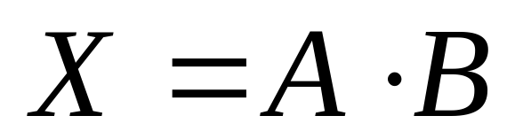

Logical Operations: AND
The AND operation has 2 or more inputs.
The output is a 1 if and only if all the inputs are 1’s.
Truth Table:
Input A | Input B | Output X
0 | 0 | 0
0 | 1 | 0
1 | 0 | 0
1 | 1 | 1
Boolean Equation:
Circuitry Symbol:

Slide 42
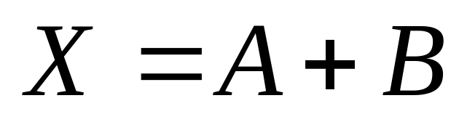

Logical Operations: OR
The OR operation also has 2 or more inputs.
The output is a 1 if any of the inputs are 1’s.
Truth Table:
Input A | Input B | Output X
0 | 0 | 0
0 | 1 | 1
1 | 0 | 1
1 | 1 | 1
Boolean Equation:
Circuitry Symbol:

Slide 43
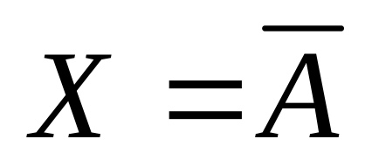

Logical Operations: NOT
The NOT (or inversion) operation has 1 input.
The output is a 1 if the input is 0 and 0 if the input is 1.
Truth Table:
Input A | Output X
0 | 1
1 | 0
Boolean Equation:
Circuitry Symbol:

Slide 44
Compound Logical Operations
The NOR operation : an OR followed by a NOT.
  The output is zero if and only if at least one input is 1.
The NAND operation: an AND followed by a NOT.
  The output is zero if and only if all the inputs are 1.
The XOR (“exclusive” OR) operation:
  Gives a 1 if one and only one input is a 1.
  Used a lot in cryptography.
The XNOR operation: an XOR followed by a NOT.
  Gives a 0 if one and only one input is a 1.

Slide 45
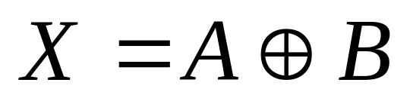
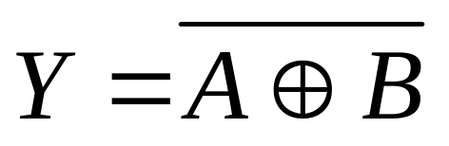


Logical Operations: XOR and XNOR
Truth Table:
Input A | Input B | Output X (XOR) | Output Y (XNOR)
0 | 0 | 0 | 1
0 | 1 | 1 | 0
1 | 0 | 1 | 0
1 | 1 | 0 | 1
Boolean Equations:
Circuitry Symbols:

Slide 46
Bitwise Logical Operations
We often perform logical operations on binary numbers “bit-by-bit”:
  Example: 1010⊕0110=1100
Bitwise operations can also be performed on decimal and hexidecimal numbers:
  Example: 5=101 and 7=111 so 5⊕7=010=2
  Example: 0xFE⊕0xDD=11111110⊕11011101 =00100011=0x23.

Slide 47
The XOR Function in Cryptography
Plaintext 6
0 | 1 | 1 | 0
The bitwise XOR function is often used in cryptographic algorithms.
Ciphers nearly always represent messages (or symbols) as numbers, which are amenable to bitwise operations.
This simple example would not make a very good cipher (why not?)
Algorithms like DES and AES make use of it in combination with other things like shifting and permutation.
⊕
Key 13
1 | 1 | 0 | 1
=
Ciphertext 11
1 | 0 | 1 | 1
Transmission
Encryption Function
Ciphertext 11
1 | 0 | 1 | 1
⊕
Key 13
1 | 1 | 0 | 1
=
Plaintext 6
0 | 1 | 1 | 0
Decryption Function
Notes:
This is a very simple “symmetric” cipher – it uses the same key for encryption and decryption. Although it is not a very useful cipher in this form, many useful ciphers employ this same principle but with a key which changes between successive symbols to confuse the cryptanalyst (code breaker).

Slide 48
Bitwise Shifting
Another bitwise operation commonly used in cryptography is “bitwise rotational shifting”
When the number of bits in a number is represented in binary, all those bits are shifted a number of spaces to the left or to the right (with “wraparound”)
  Example: Decimal 13 (0xD) is represented in 4 bits. Shift this number two spaces to the left.
  13=1101. Left shifted two places this becomes 0111 which is decimal 7 (or 0x7)

Slide 49
7.
Frequency Analysis and Histograms

Slide 50
Frequency
We will need the concept of “frequency” next week when we consider random substitution ciphers.
Frequency is a measure of how often a particular random outcome is observed to happen in a given number of observations
  Example: if you throw a die 200 times and get 40 sixes, the frequency of throwing a 6 is 40/200=0.2 or 20%
  Frequency is not quite the same thing as probability, which is the expected (or theoretical) value of frequency.
  What would be the probability of throwing a 6 or a 4?
Notes:
This kind of frequency has nothing to do with frequency in electrical signals (measured in Hz)
The probability of getting a 6 or a 4 would be 1/6 (for a 6)+1/6 (for a 4) = 2/6=1/3=0.333=33.3% (approx.)

Slide 51
Frequency Distribution
A frequency distribution is a set of frequencies for all possible outcomes. E.g. we throw a die 50 times and get…
A histogram is a bar chart representing a frequency distribution.
Number Rolled | Observations | Frequency (%)
1 | 10 | 20
2 | 16 | 32
3 | 4 | 8
4 | 7 | 14
5 | 5 | 10
6 | 8 | 16

Slide 52
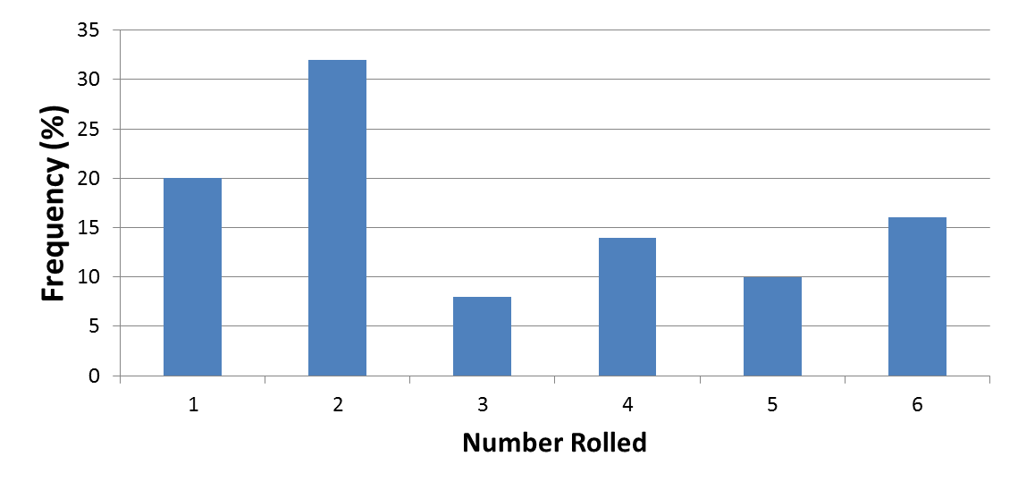
Frequency Histogram
Question: What would we expect to see if we increased the number of rolls to 100, 1000 or 10,000?
Notes:
If you want to check this out there is quite a handy dice-simulator at http://academic.evergreen.edu/curricular/doingscience/flash/dice.html
There is a useful technique called the “chi-squared test” which assesses the plausibility that an observed frequency distribution arose from a proposed probability distribution. It is beyond the scope of this course, but if you are interested there are several good videos on it on YouTube, e.g. https://www.youtube.com/watch?v=WXPBoFDqNVk.

Slide 53
Summary
Arithmetic and Number Systems
Prime and Composite Numbers
  The difference between them
  Techniques and problems with finding prime numbers
  The concept of “relative” primality.
Integer Arithmetic
  Quotients and remainders. Greatest Common Divisors
Modular Arithmetic
  Modular congruency
  Using the Euclidian Algorithm (today’s workshop)

Slide 54
Summary
Number Bases
  Decimal, binary and hexadecimal number systems
Logical Operations and Logic Gates
  AND, OR, NOT, XOR (especially XOR)
  Bitwise shifting
Frequency Analysis and Histograms
Keep a copy of these slides handy – you will probably need to refer back to them in coming weeks.

Slide 55
Homework
Do the Online Quiz
Do the “Exam Question” homework exercise
  Watch this video about the history of cryptography https://www.youtube.com/watch?v=H9Cu36Qj3dQ

Slide 56
Additional Homework
You may enjoy reading either:
  “The Adventure of the Dancing Men” by Sir Arthur Conan Doyle (http://www.eastoftheweb.com/short-stories/UBooks/AdveDanc.shtml, audiobook at https://www.youtube.com/watch?v=TbuKf-s6wOM)…
  …or “The Gold Bug” by Edgar Allen Poe (http://poestories.com/read/goldbug, audiobook at https://www.youtube.com/watch?v=PHlu-gJ_gDA)

